Slide 1
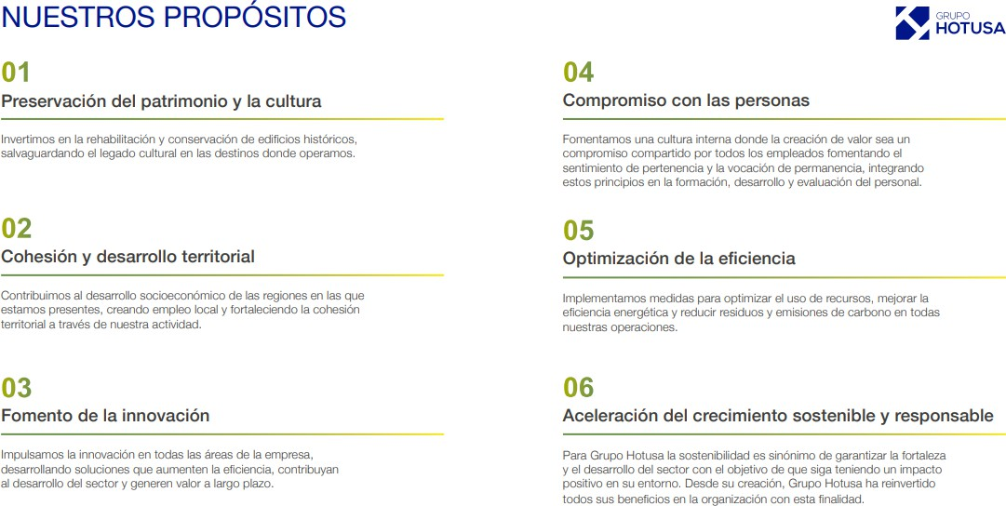

Slide 2
OUR SUSTAINABILITY STRATEGY
Grupo Hotusa's sustainability strategy is structured around three pillars:
People
This pillar focuses on the well-being of our employees and their professional and personal growth. We strive to generate employment beyond major urban centres, ensuring a positive social impact both within and outside the organisation.
We have implemented initiatives that promote equal opportunities and talent development, ensuring that every action reflects our commitment to the well-being of our workforce and the communities in which we operate.
Environment
Our commitment to sustainability is reflected in investments and measures designed to reduce natural resource consumption and minimise our carbon footprint. We are committed to continuously improving our environmental practices, ensuring that our business growth remains responsible towards the environment.
Through this pillar, we manage our environmental impact by promoting conservation, the efficient use of resources, and the reduction of our ecological footprint.
Good Governance
Aligned with our fundamental principles, we have established a robust ethical framework through our Code of Ethics and Business Conduct. This code sets out clear guidelines to ensure integrity in our workplace, business practices, and relationships with society.
This pillar ensures that the company operates ethically and responsibly, applying governance principles that foster transparency and protect the rights of all stakeholders. Furthermore, it reaffirms our commitment to reinvesting 100% of our profits, a policy we have upheld since our inception.

Slide 3

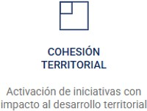
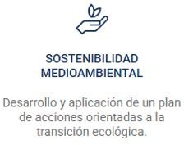
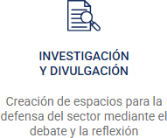


Slide 4
TRAINING AND EMPLOYABILITY
Development of Potential Grupo Hotusa promotes talent retention and professional development through a strategic plan that aligns corporate goals with individual aspirations. This approach strengthens the connection between personal growth and the company’s objectives, fostering a committed team aligned with its values.
Internal Training Programmes Investing in training not only ensures compliance with the quality standards set by the group but also enhances the experience and service received by our customers. Additionally, it plays a key role in ensuring adherence to internal and external regulations, contributing to operational excellence.
Dual Training and Professional Development The organisation is committed to the Dual Training model as a formula that promotes dynamic learning closely linked to the professional world. In this way, we facilitate the integration of young professionals into the business sector, helping them develop within various fields of the industry.
Activities in Collaboration with Universities Grupo Hotusa organises the annual inter-academic competition Talent Match, part of the Smart People programme. This initiative provides students with their first contact with the business world and professional dynamics through the resolution of real-world challenges.
ONGOING ACTIVITIES
Talent Match Project – Visit the website
Dual Training Programmes
Collaborations with foundations to support the training of people at risk of social exclusion

Slide 5
TERRITORIAL COHESION
At Grupo Hotusa, we understand that territorial cohesion is key to the sustainable development of regions. Through our business activities, we seek to strengthen the social and economic fabric of the areas in which we operate, actively contributing to their dynamism and well-being.
Creation of Work Centres Outside Urban Hubs One of our main focuses is the establishment of work centres outside major urban areas. Grupo Hotusa is committed to decentralisation by setting up work centres in rural areas, fostering employment and economic development. A notable example is the centre in Chantada (Lugo), which already employs over 250 people, reflecting our commitment to equitable growth and improving life in rural regions.
Organisation of Sporting Events Grupo Hotusa strengthens its connection with the destinations where it operates through sporting events held throughout the year, promoting a healthy lifestyle and fostering community engagement. A key example is the vertical races at Eurostars Madrid Tower and Eurostars Torre Sevilla, which attract numerous participants annually, creating a meeting point between the local population and the hotel.
Pazo Recimil Project
Eurostars Hotel Company has developed an exclusive gastronomic project that integrates the breeding and production of its own ox meat for its restaurants. This initiative takes place at Pazo Recimil, an estate in Lugo, Galicia, where the animals are raised in a semi-stabled system.
Beyond offering high-quality products and an exceptional dining experience, this project ensures animal welfare and contributes to the economic and social development of Galicia. The restoration of Pazo Recimil, previously in a state of semi-abandonment, reinforces territorial cohesion and boosts the local economy through sustainable practices.

Slide 6
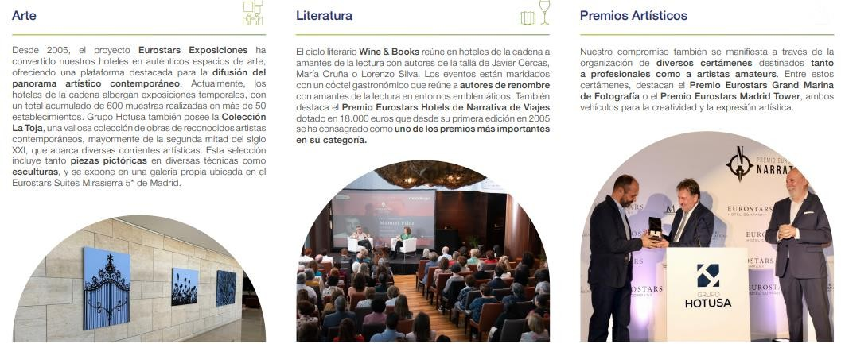
COMMITMENT TO CULTURE Through Eurostars Hotel Company, Grupo Hotusa has established itself as a leader in cultural initiatives. These efforts not only promote creativity but also enrich society by fostering culture. The company’s cultural project has gained national recognition, becoming a key player in the cultural and artistic scene and positioning itself as a platform that supports and promotes emerging artists.
ONGOING ACTIVITIES
Literary and Photography Awards and Competitions – Visit the website
Wine & Books Literary Encounters – Visit the website
Exhibition Agenda in Hotels – Visit the website

Slide 7
Historical Heritage Rehabilitation Throughout our history, we have led rehabilitation projects that preserve heritage, transforming historic buildings into hotels that celebrate their artistic and architectural value. Some of the most iconic examples can be found in the Aurea brand hotels, where many of the establishments, originally convents, palaces, or old estates, have been carefully restored. In some cases, these hotels also house remnants of ancient civilisations, offering guests a unique and singular experience.
These transformations not only ensure the preservation of heritage but also revitalise it, turning these spaces into tourist destinations that generate both economic and cultural value. It is a way to promote sustainable tourism that preserves and enhances historical and cultural heritage.
ONGOING ACTIVITIES
Projects for the recovery of historic buildings
Aurea Palacio de Correos Reconstruction Project – Watch video
Aurea Toledo Reconstruction Project – Watch video
Historic Hotels – Visit the website

Slide 8
CHARITY EVENTS Development of charity events to raise funds for various causes Throughout the year, Grupo Hotusa organises various charity galas and dinners with the aim of raising funds for social causes that require the support of the entire community. These initiatives not only serve to collect funds but also seek to raise awareness about the challenges we face as a society. Grupo Hotusa demonstrates a strong commitment to charitable causes, reflecting its sensitivity towards social responsibility. Every action the company undertakes aims to create a positive impact in its area of influence.
Participation in Charity Initiatives For Grupo Hotusa, these collaborations represent a desire to create a lasting impact. Our activities focus on supporting initiatives that offer organisations the facilities and resources to drive their projects and visions.
(Logos of entities)
ONGOING ACTIVITIES
Organisation of Charity Gala at Eurostars Torre Sevilla
Organisation of Charity Gala at Eurostars Madrid Tower
Organisation of Charity Gala at Eurostars Gran Hotel La Toja
Sponsorship of events linked to charitable causes

Slide 9


Slide 10
ENVIRONMENTAL SUSTAINABILITY
Development of an Ecological Transition Plan The organisation is actively developing a plan of actions aimed at an efficient ecological transition for the company and its hotels.
The roadmap includes reducing energy and water consumption, CO2 emissions, as well as waste reduction and promoting recycled materials. The focus is on minimizing the environmental impact, supporting local communities, driving new sustainable consumption patterns, and promoting a regenerative tourism model that not only aims to minimize the negative impact on destinations but also enriches the environment.
NATURAL RESOURCE MANAGEMENT Efficient use of water and energy Implementation of sustainable sourcing and production practices
EMISSIONS AND CLIMATE CHANGE Grupo Hotusa is committed to reducing its CO2 emissions, and to achieve this, it is making a significant investment in sustainable technologies and training. These investments reflect its commitment to sustainable practices that will significantly reduce its environmental impact and help meet its environmental goals.
WASTE AND POLLUTION We have a waste management and sorting protocol aimed at establishing a uniform and efficient system for waste segregation and management across all hotels in our chain.
FOOD PROGRAM This program focuses on reducing organic waste produced in the hotels of Eurostars Hotel Company of Grupo Hotusa.

Slide 11
PLASTIC FREE PROGRAM The Plastic Free program focuses on reducing the use of plastics in the hotels of the Eurostars Hotel Company chain.
CONSERVATION OF BIODIVERSITY AND ECOSYSTEMS At Grupo Hotusa, our sensitivity towards sustainability and respect for the environment is reflected in our commitment to preserving biodiversity in our hotels.
CERTIFICATIONS AND TRANSPARENCY At Grupo Hotusa, we have established a series of processes and measures to ensure transparency, quality, and compliance with international standards in our operations. These efforts are reflected in the following initiatives:

Slide 12
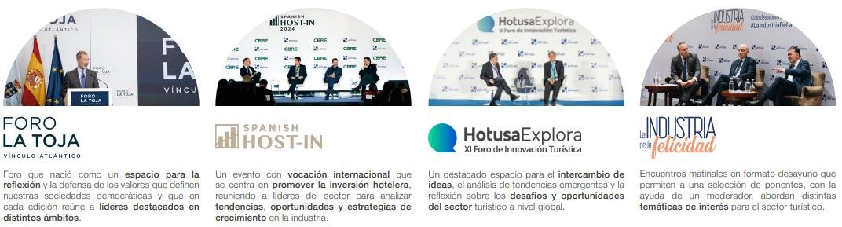
RESEARCH AND OUTREACH Creation of spaces for meeting, debate, and reflection The organization advocates for the Dual Training model as a dynamic learning approach closely linked to the professional world. In this way, we facilitate the entry of young professionals into the business world, helping them develop within the sector across its various fields.
ONGOING ACTIVITIES Hotusa Explora Forum Visit the website Breakfast The Happiness Industry Visit the website Afterwork Hotusa Meetings Visit the website La Toja Forum - Atlantic Link Visit the website Spanish Host In Visit the website

